Slide 1
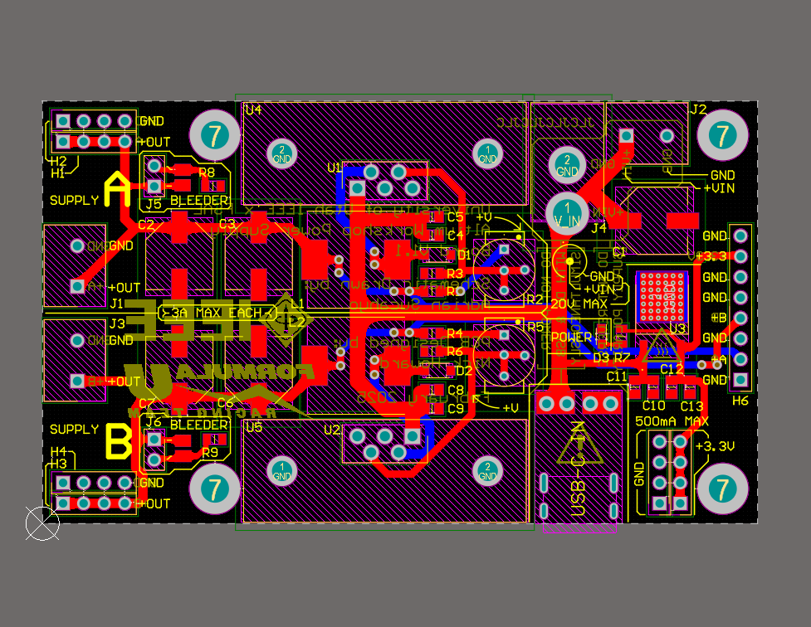
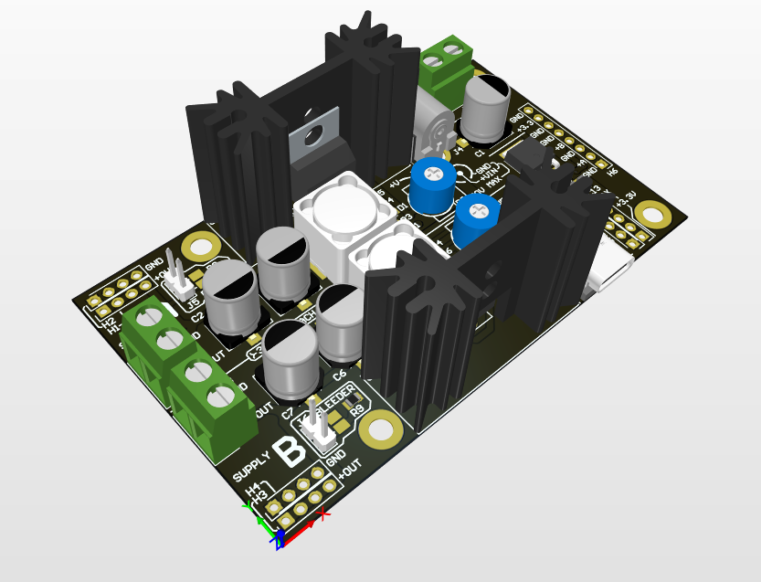

IEEE x FSAE Altium Workshop Week 2: Introduction to Printed Circuit Board Design (Power Supply)
Hosted by: Nick Howard & Adrian Sucahyo

Slide 2
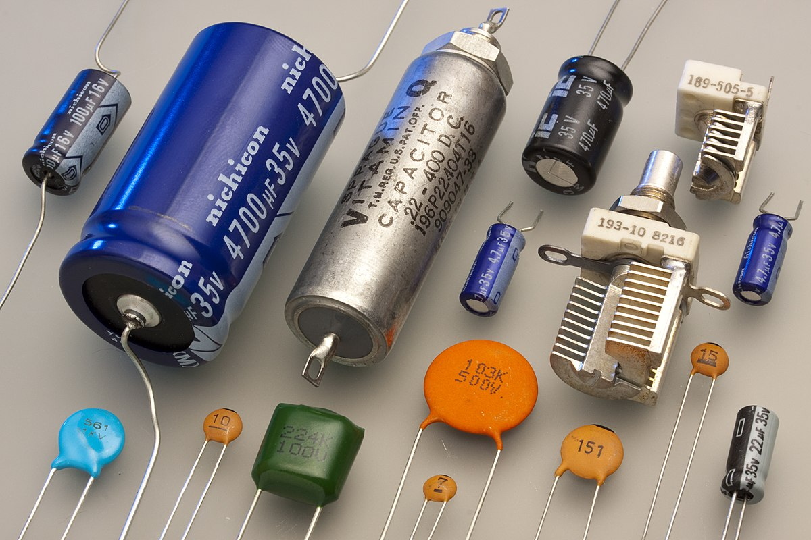
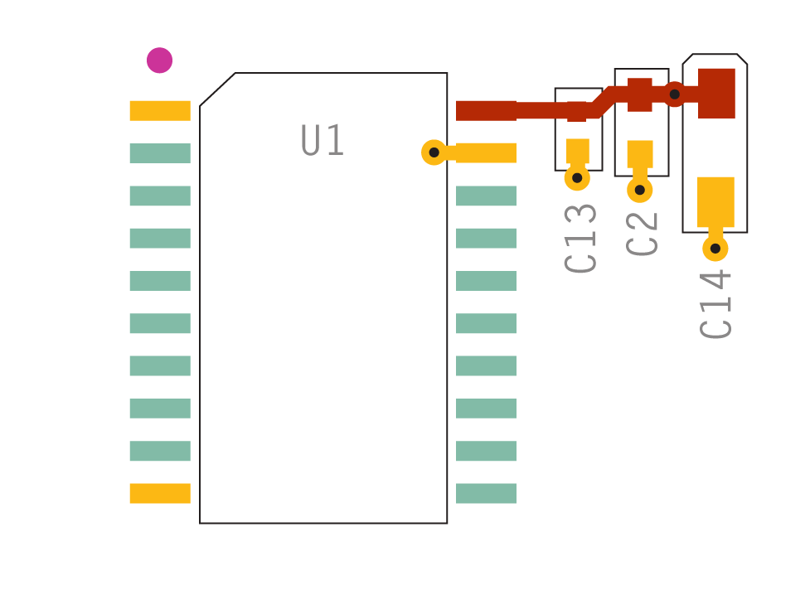
Quick Note: Capacitors
Capacitors store electric charge
Useful for stabilizing voltages on a circuit board
Bulk capacitors supply current when supply is inadequate
Typically electrolytic
Supplies current for ~milliseconds
Decoupling capacitors provide local stability for rapidly changing loads (such as high-speed logic)
Typically tantalum/ceramic
Supplies current for ~microseconds/nanoseconds
Image credit: Eric Schrader & Sierra Circuits
https://www.protoexpress.com/blog/decoupling-capacitor-placement-guidelines-pcb-design/

Slide 3
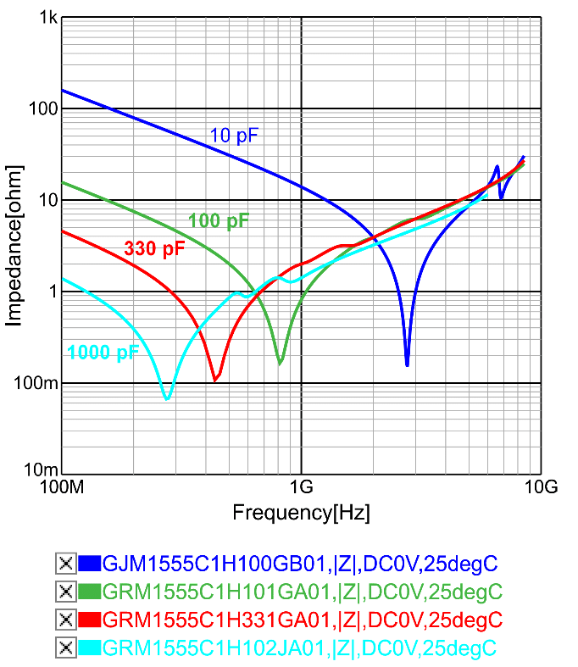
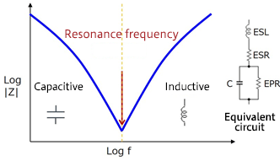
Quick Note: Capacitors
Capacitors are not ideal!
Equivalent Series Resistance (ESR)
Equivalent Series Inductance (ESL)
Equivalent Parallel Resistance (EPR)
Due to ESL, capacitors can self resonate
Beyond the resonance frequency, capacitors will act like inductors!
To maximize decoupling performance, multiple capacitors of various values are often connected in parallel
100nF + 1uF + 10uF, for example
If you’re not too concerned about high frequencies on your board (~MHz), just use a single decoupling capacitor
If very high frequencies are of concern (MHz-GHz), use multiple decoupling capacitors.
Image credit: Tech Web & Egor Gurov
https://techweb.rohm.com/product/nowisee/7549/
https://www.researchgate.net/figure/Simple-ceramic-capacitor-model_fig2_335195168

Slide 4
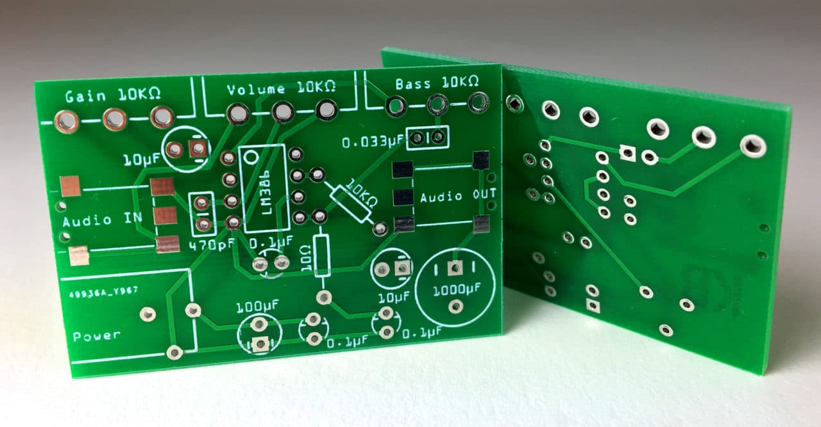
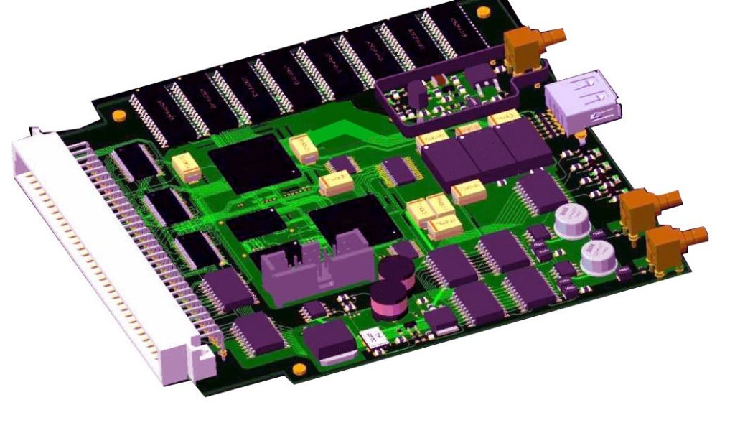
Printed Circuit Boards (PCBs)
Stack of conductive and nonconductive layers used to connect electrical components in a circuit
Used in nearly all electronics
Components are soldered to the PCB on one or both sides
Cheap to produce and can be rapidly manufactured
Image credit: Circuit basics & Sierra circuits
https://www.circuitbasics.com/make-custom-pcb/
https://www.protoexpress.com/blog/10-best-pcb-layout-design-tools-recommended-by-pcb-designers/

Slide 5
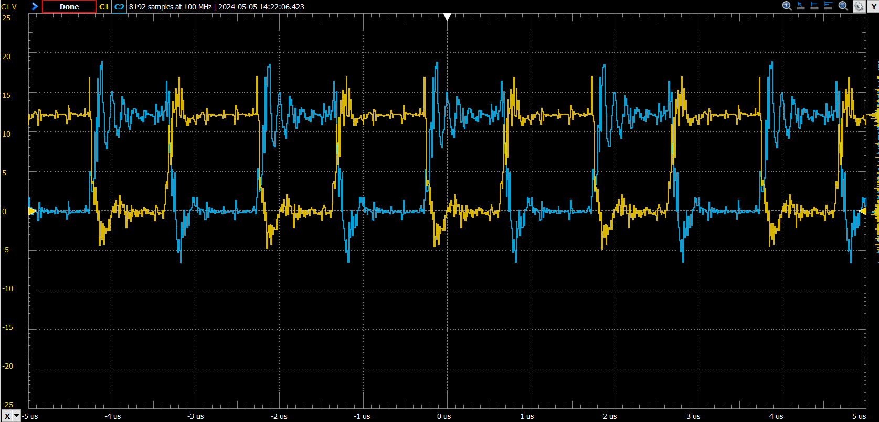
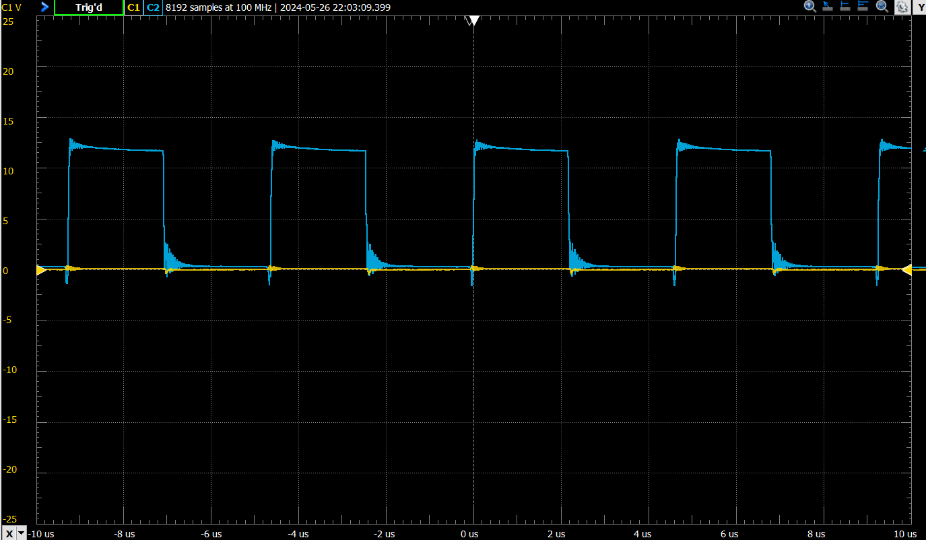
Why use PCBs?
PCBs are the industry standard for connecting electronics
Superior performance when compared to perfboards or breadboards
Easy to assemble
Relatively cheap
Durable
Occupy minimal space

Slide 6
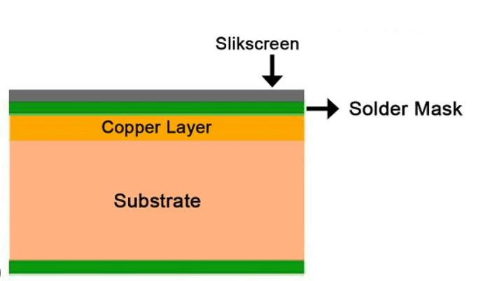
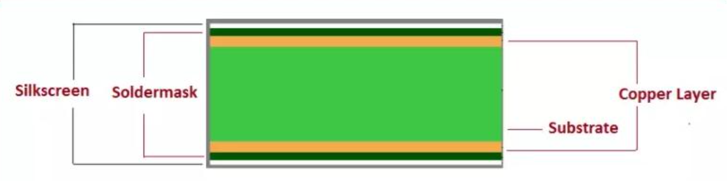
PCB Composition
PCBs consist of many layers
The substrate provides mechanical support and structure. Typically made of FR-4 (flame-retardant fiberglass)
Copper layers electrically connect components and provides cooling
Solder masks shield and insulate the copper layer
Silkscreens are used to print symbols/text on the board surface
Image credit: Elecrow
https://www.elecrow.com/all-about-multilayer-pcbs-you-should-know-printed-circuit-board

Slide 7
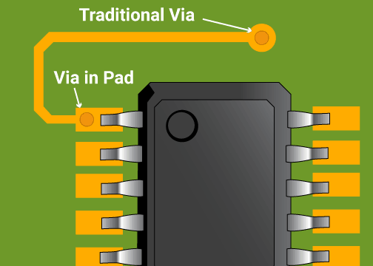
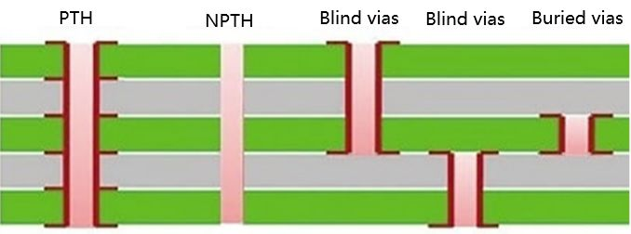
Pads, Traces, Vias, and Through-Holes
Pads are used to solder components (holes in the solder mask)
Traces electrically connect components
Vias electrically connect different layers
Through-holes pass through the entire board
Plated through-holes (PTHs) are plated and non-plated through-holes (NPTHs) are not
On two-layer boards, vias and PTHs are very similar, however vias are typically smaller and covered by the solder mask layer
Image credit: Sierra Circuits & ankecircuit
https://www.protoexpress.com/blog/what-is-pad-pcb-design-development/
https://www.ankecircuit.com/news/the-classification-and-function-of-holes-on-pcb/

Slide 8
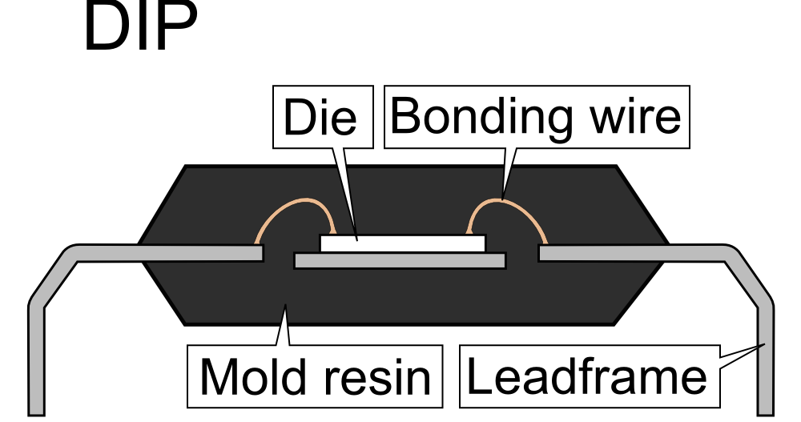
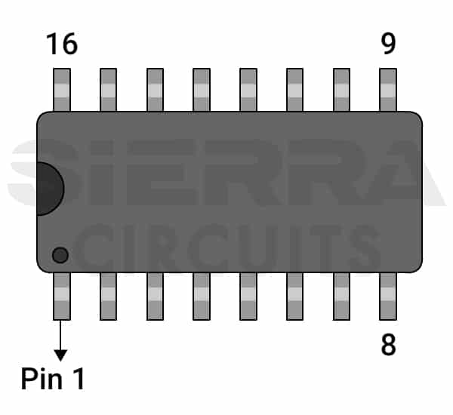
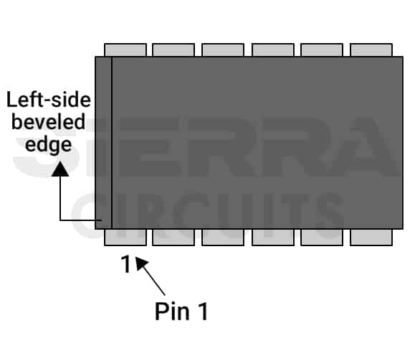
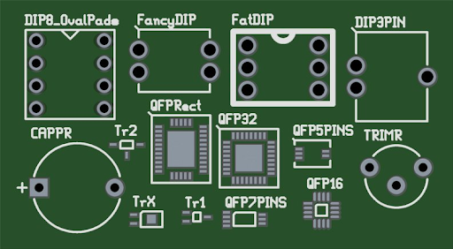
Device Packages and Footprints
ICs are housed in a “package”
Packages can be surface mount or through-hole
Each package has a unique footprint
Footprints are the arrangement of pads/through-holes used to attach and electrically connect a component to a PCB
The pattern of pads on the PCB matches the pattern of leads on the package
Pin 1 is identified on the package with a dot, line, or beveled edge
Pin 1 is identified on the footprint with a dot, line, or arrow
Image credit: Wikimedia commons, sierra circuits, & morepcb
https://en.wikipedia.org/wiki/Integrated_circuit_packaging
https://www.protoexpress.com/kb/how-to-add-and-identify-pin-1-marking-in-your-pcbs/
https://morepcb.com/pcb-footprint/

Slide 9
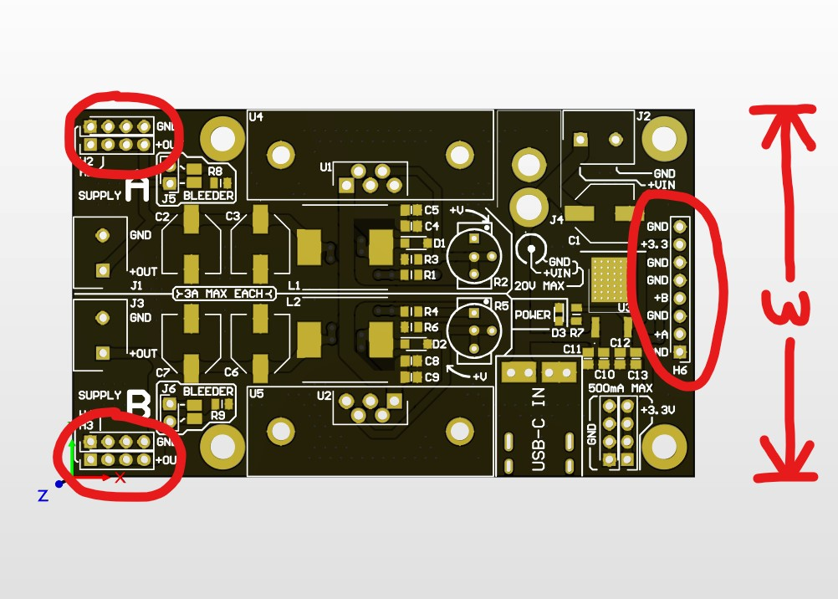
Project Overview (Power Supply)
Today we will begin work on the power supply PCB
Please use the provided schematic to ensure functionality
You are free to design the PCB however you like, although we strongly recommend using the same board width & header placements as the example board
If you would like to add additional components (fuse, LEDs, additional headers, etc.) please talk to us
We likely cannot provide parts unique to your board

Slide 10
Questions?

Slide 11
Download Today’s Project Files
Navigate to the workshop GitHub and download today’s files listed under Week02
https://github.com/AdrianSucahyo/IEEE-PCB-Workshop-Resources-2025

